Slide 1
GIS-optimized last-mile parcel locker network design for a city:
A Multi-Objective Approach
Project Team
Wadje Rushikesh Govindrao
Raihan S Basheer
Ron Sinoy
Muhammed N V
Guide
Dr. Vinay V Panicker
BTech Project Part 1 | ME3099E
NIT Calicut | March 2026

Slide 2
CONTENTS
Introduction
Major Literature
Problem Statement
Project Objectives
Results Obtained
Methodology
Conclusion
Future expansions planned
References

Slide 3
Introduction
The Problem
Our Approach
Last-mile delivery of goods accounts for 53% of total supply chain cost
Indiranagar, Bangalore: dense residential + IT corridor = high parcel volume (Using synthetic data generated by large language models )
Failed deliveries = Huge economic losses
20 candidate locker sites, 621 demand grid cells in 3 km × 3 km area
Research Question: Which 15 sites can be chosen to install Parcel Locker System (PLS) to minimize the total system cost and carbon emission, while maximizing coverage?
Bi-level optimization: formulating to minimize cost (upper), carbon emissions and maximize customers’ utility (lower)
Utility function: proximity 45%, safety 25%, transit 20%, flexibility 10%
Bipartite Network Analysis: using the Dual and Coverage Centrality metrics to evaluate the structural resilience of our proposed sites. This ensures the network remains functional even if a major hub is disrupted by traffic or weather.
Discrete-Event Simulation : using to validate the optimization model by simulating real-world delivery cycles to quantify the reduction in fuel consumption and CO₂ emissions.

Slide 4
Major Literature
Dayal, E., Unnikrishnan, A., Pani, A., & Lakshay. (2025). Optimal Location and Capacity Planning for Parcel Lockers: A Bi-Level Optimization Model. Transportation Research Record, 2679(5), 968–980.
Sawik, B., Hernandez, A., Muro, A., Faulin, J., 2022. Multi-Criteria Simulation-Optimization Analysis of Usage of Automated Parcel Lockers. Math. 10(23)
Corradini, R., et al. (2025). Bipartite Network Analysis for Supply Chain Resilience. Transportation Research Part E, 193, 103852.
Hovi, I. B., & Bø, E. (2024). Unlocking the Potential: How Can Parcel Lockers Drive Efficiency and Environmental Friendliness? Sustainable Futures, 7, 100189.
Hagberg, A., Swart, P., & Chult, D. (2008). Exploring Network Structure, Dynamics, and Function using NetworkX. Proc. SciPy 2008, 11–15.

Slide 5
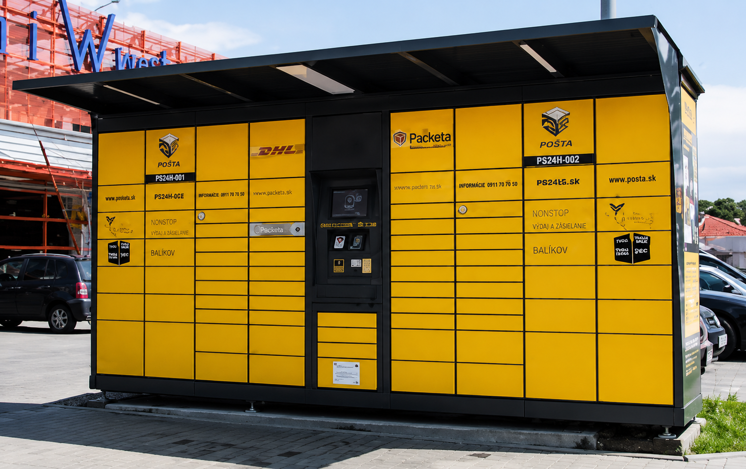
What is a Parcel Locker System?
Definition
Automated postal lockers are self-service parcel boxes that enable users to conveniently send, receive, and return packages while reducing last-mile delivery costs, failed deliveries, and carbon emissions.
Major Players
DHL – Global logistics leader with extensive parcel locker networks.
InPost – One of Europe’s largest providers of automated parcel machines (APMs).

Slide 6
Problem Statement
When an order is placed online in India, the package goes through several hands; but the last mile is the hardest and most expensive. The movement takes more time, costs more, and adds unnecessary emissions. This pinpoints the need for installing parcel lockers where people actually need them.
This project proceeds with a Research Question: Can GIS spatial data and delivery patterns be used to determine optimal parcel locker locations, and can this be analytically validated?
This project aims to develop a GIS-driven optimisation model, solve a multi-objective facility-location problem to minimize cost and carbon emissions. Furthermore conduct a comparative analysis with respect to doorstep delivery.

Slide 7
Project Objectives
Map demand and candidate sites using GIS and secondary data to identify candidate locker locations. For the use case, a residential location in Indiranagar, Bengaluru, is chosen.
Generate synthetic demand data using large language models which is calibrated to real census and land-use inputs.
Develop a bi-level facility-location model to optimise locker placement considering cost, carbon emission and customer utility.

Slide 8
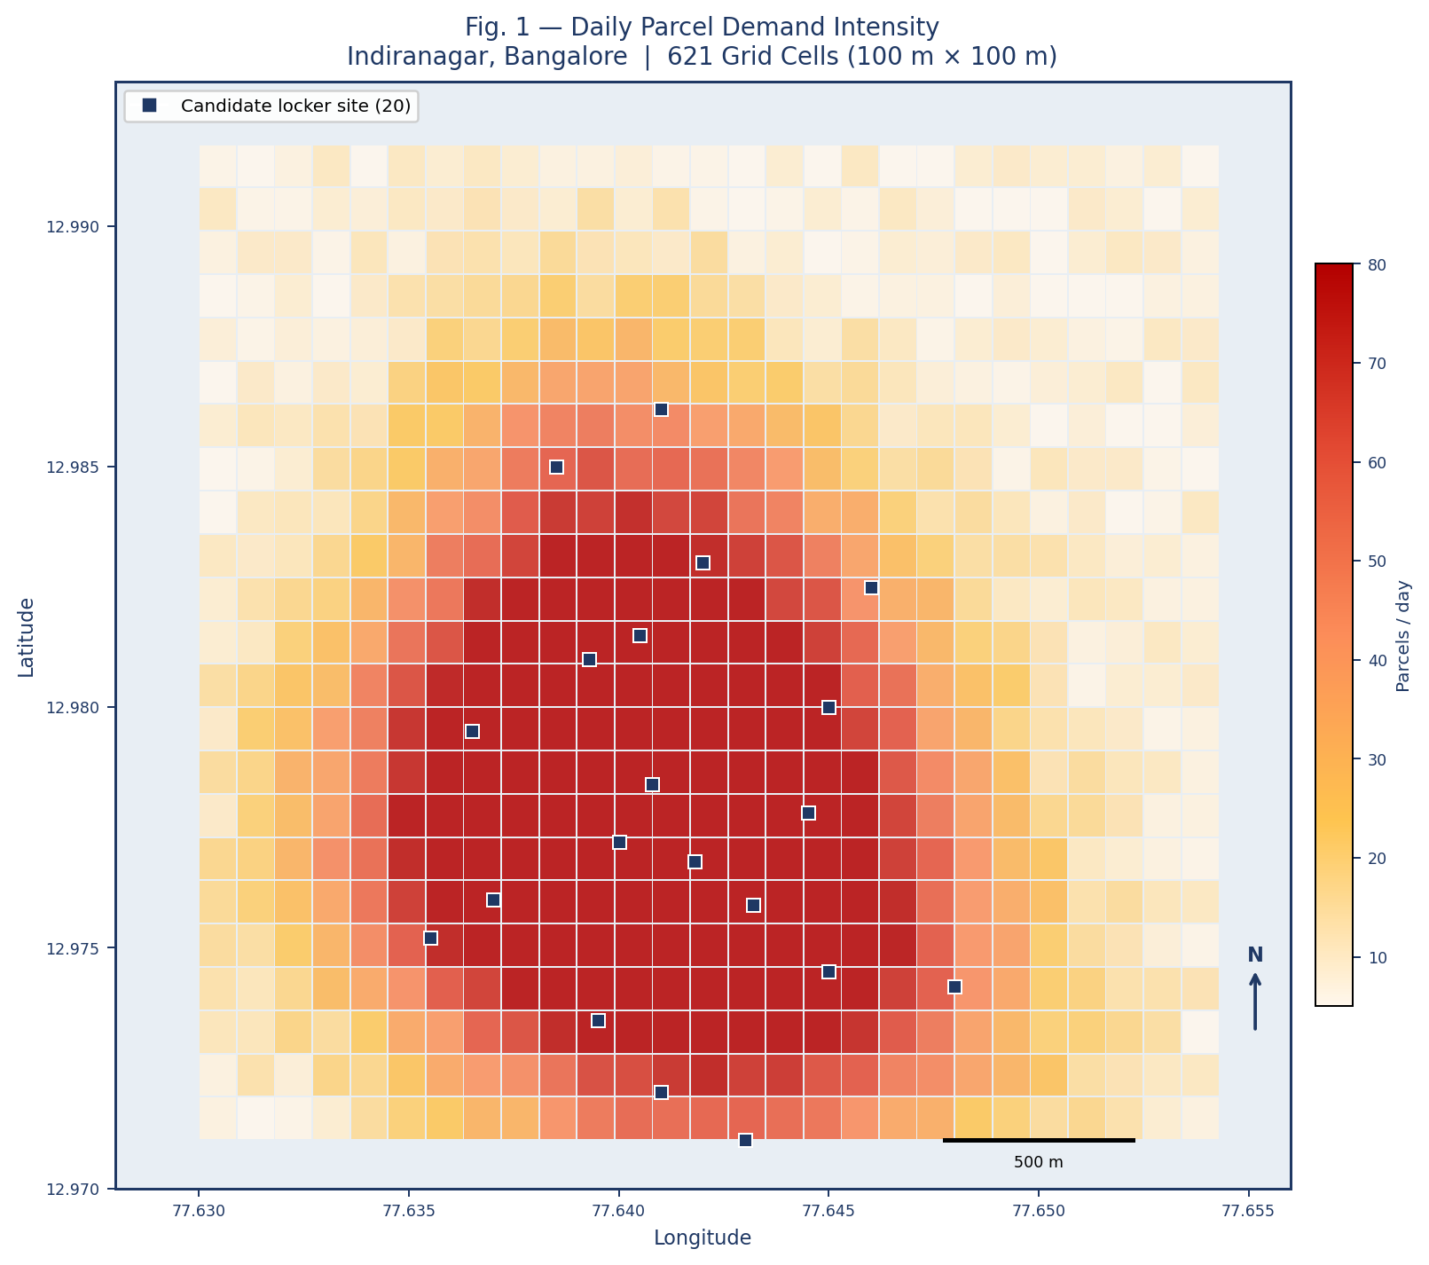
Results Obtained: Daily Parcel demand Intensity
Peak parcel demand concentrated along the central Indiranagar corridor.
Highest demand zones reach nearly 75 parcels/day per grid cell.
Secondary demand clusters observed near Domlur and HAL Colony.
Peripheral regions show consistently lower parcel activity.
Candidate locker sites aligned closely with major demand hotspots.
Indiranagar Metro corridor emerges as the most critical service zone.

Slide 9
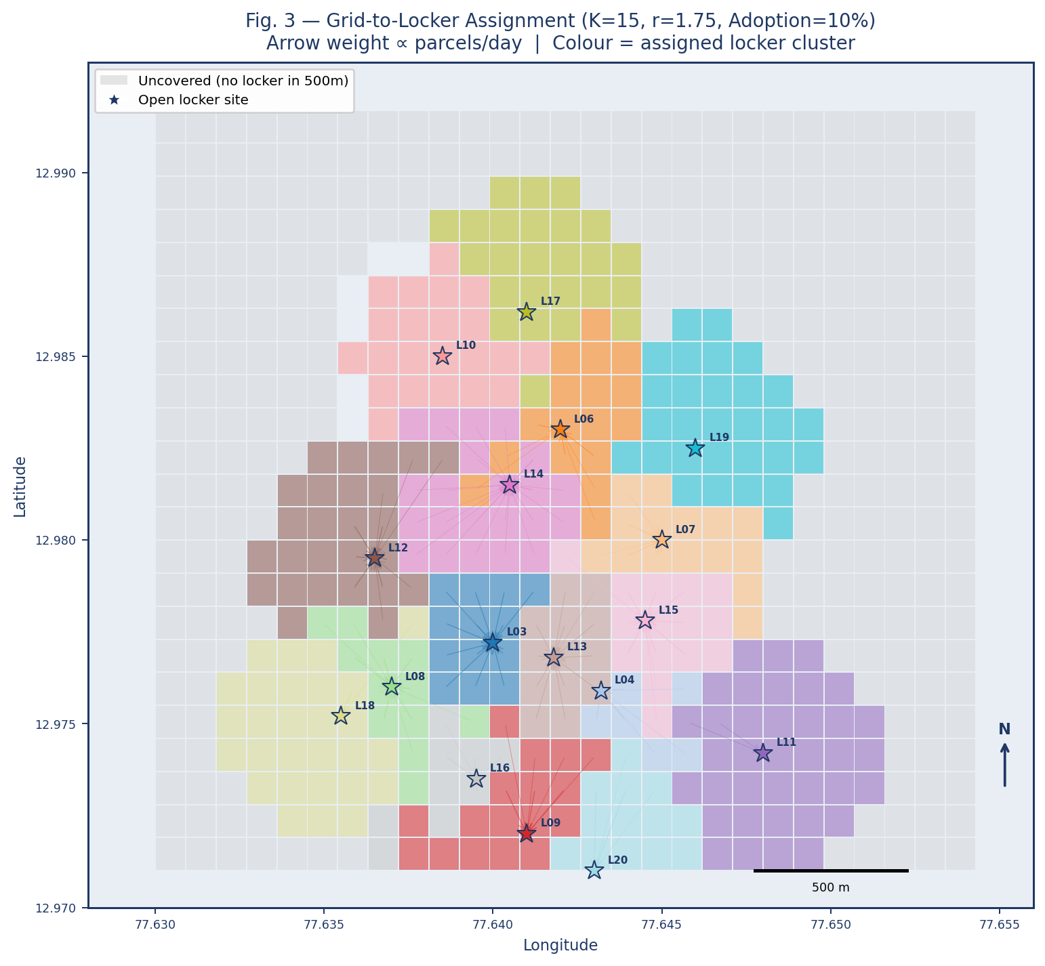
Results Obtained: Optimized Grid-to-Locker Assignment Network
Locker assignments form clear and compact service zones.
L03 and L13 handle the highest parcel demand in the network.
Central lockers share demand efficiently in overlapping regions.
Average customer-to-locker distance remains low (~217 m).
Bi-level optimization improves assignment to preferred locker locations.

Slide 10
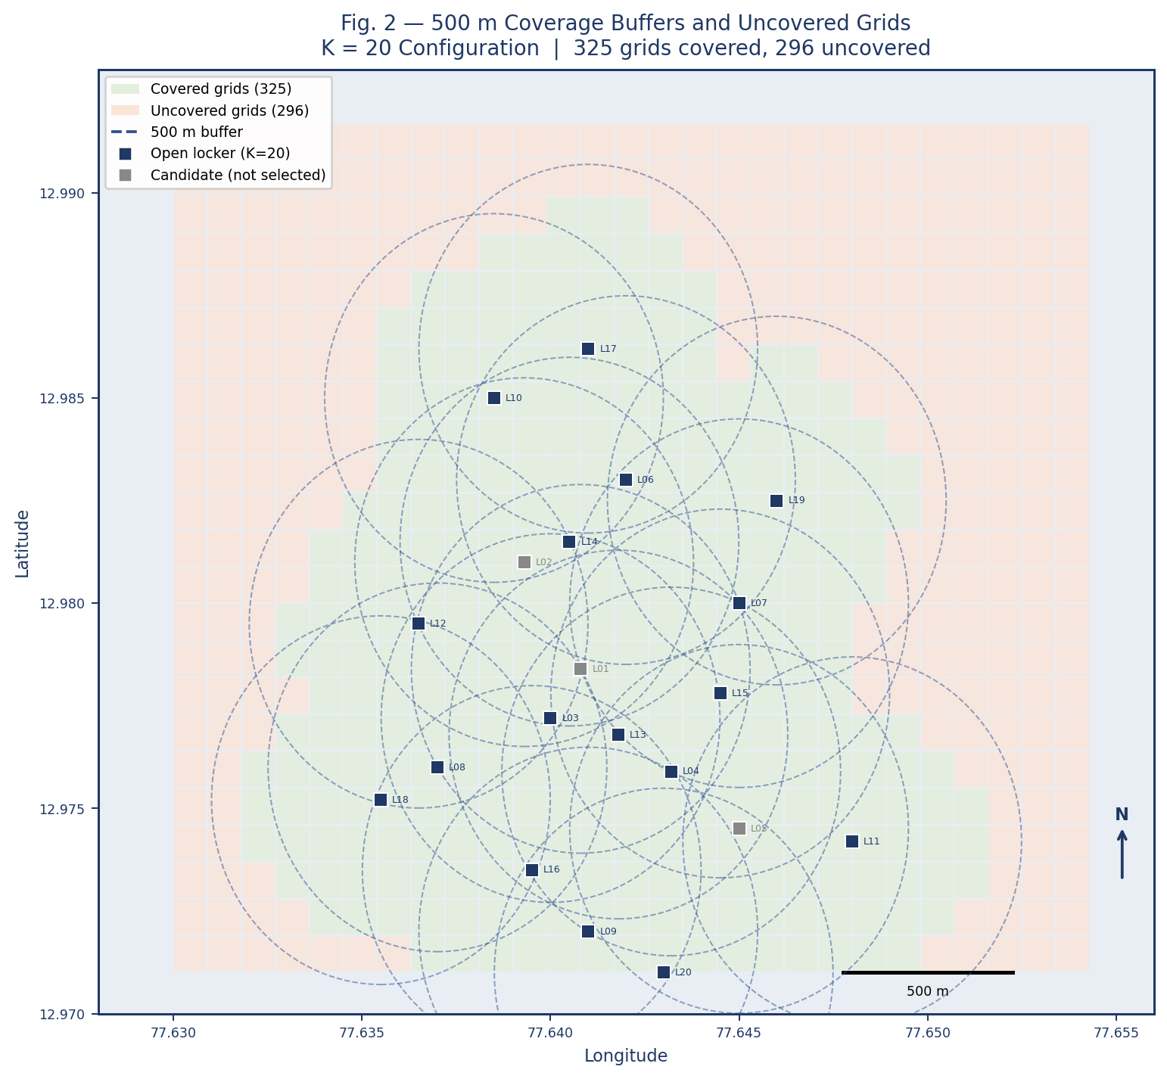
Results Obtained: 500 m Coverage Feasibility Analysis
Maximum coverage reaches only 48.9% even with all 20 lockers active.
Large peripheral regions remain uncovered due to lack of nearby candidate sites.
Strong buffer overlap in central Indiranagar indicates service redundancy.
Existing locker distribution heavily favors the central demand corridor.
Improving coverage requires new peripheral sites or relaxed walking thresholds.

Slide 11
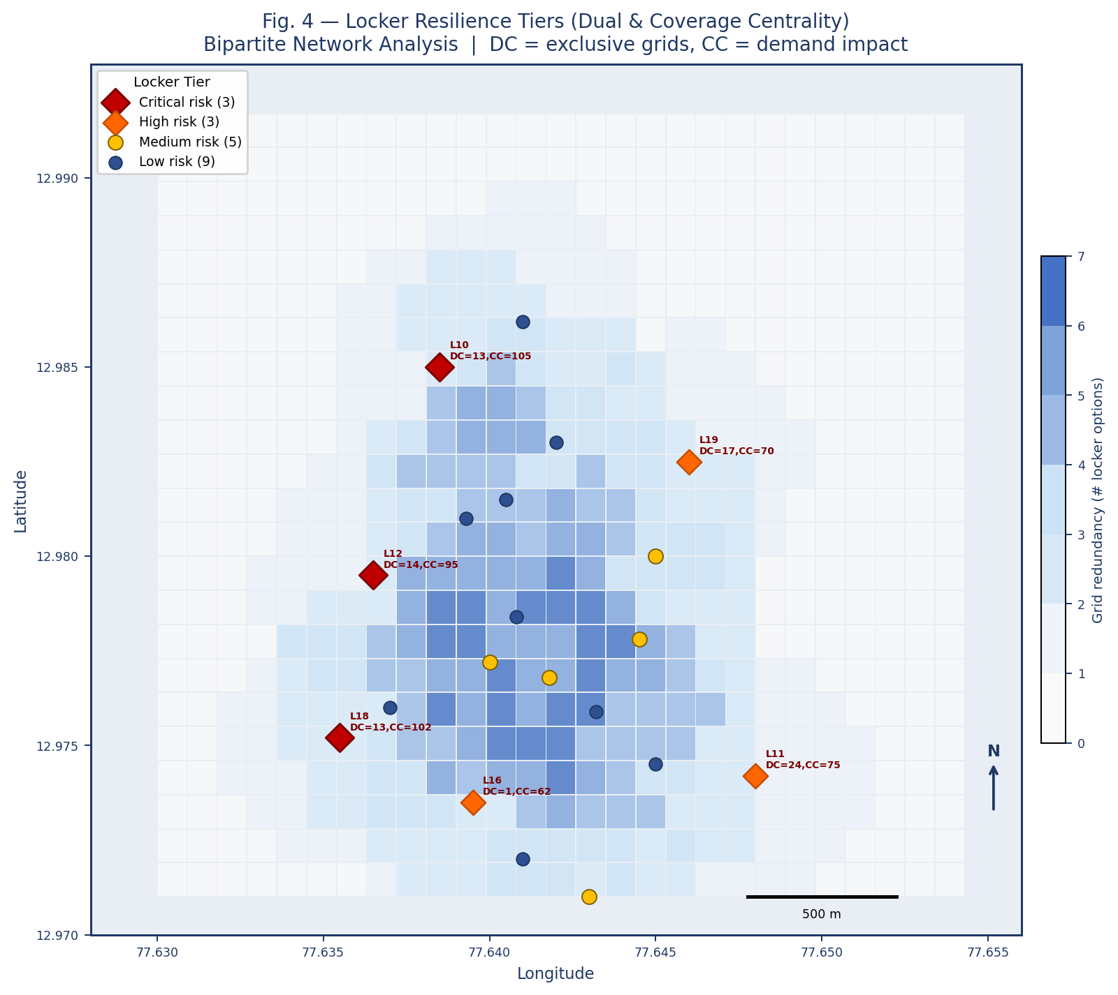
Results Obtained: Locker Resilence
L11 emerges as the most critical and irreplaceable locker in the network.
Central regions show high redundancy with multiple alternative locker options.
L10, L12, and L18 are critical due to their high demand coverage impact.
Overlapping central lockers provide strong backup support during failures.
Peripheral lockers are less replaceable despite serving lower overall demand.

Slide 12
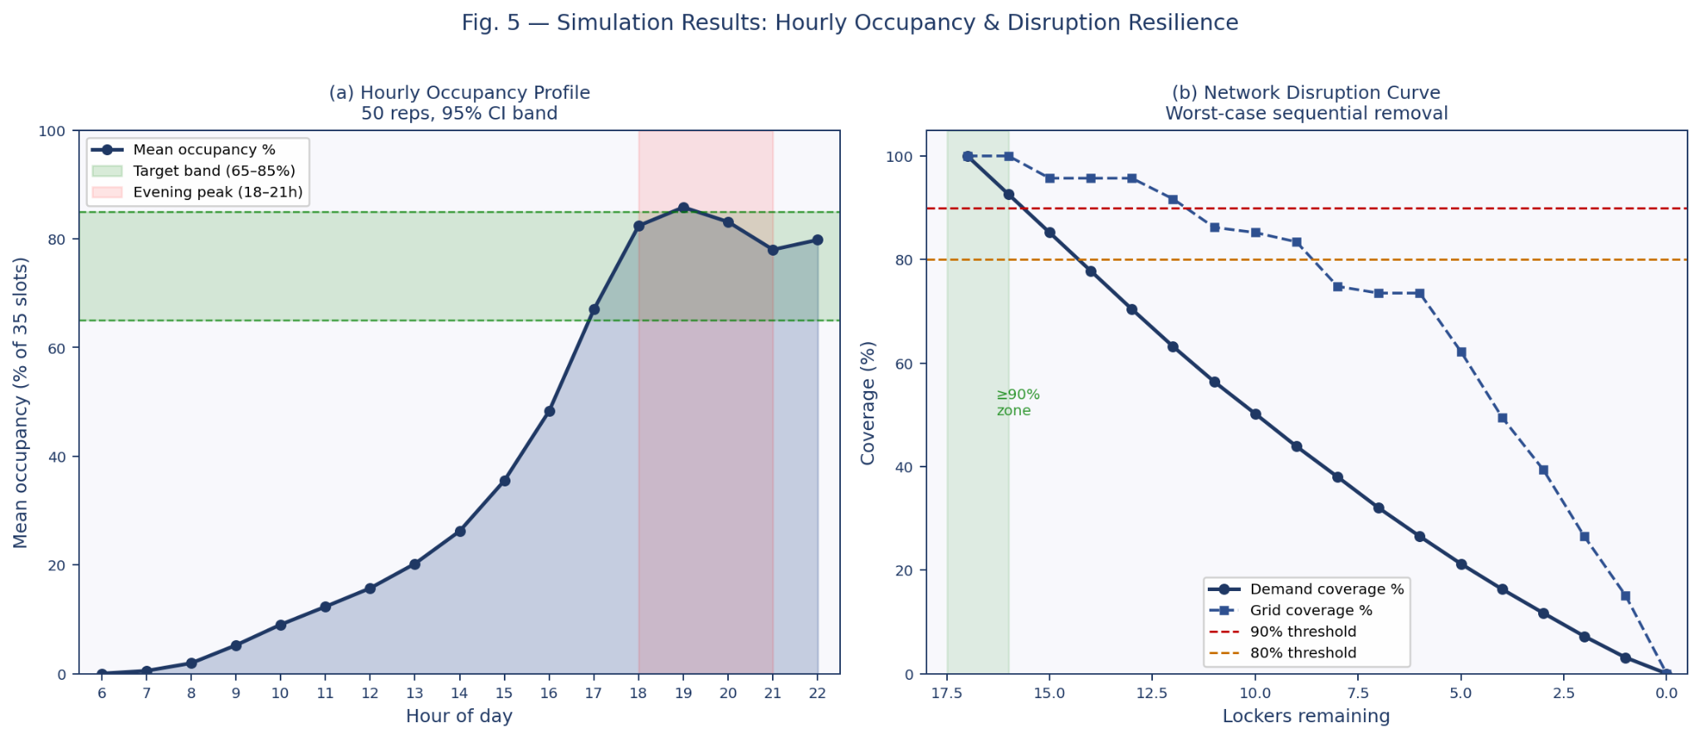
Results Obtained: Discrete-Event Simulation Validation

Slide 13
Results Obtained: Discrete-Event Simulation Validation
Locker occupancy peaks during the evening pickup window (18:00–21:00).
Peak utilization reaches nearly 86%, indicating near-saturation during high-demand hours.
Morning hours show low occupancy and under-utilization across the network.
Demand coverage decreases steadily as lockers fail sequentially.
The network drops below 90% demand coverage after a single major locker failure.

Slide 14
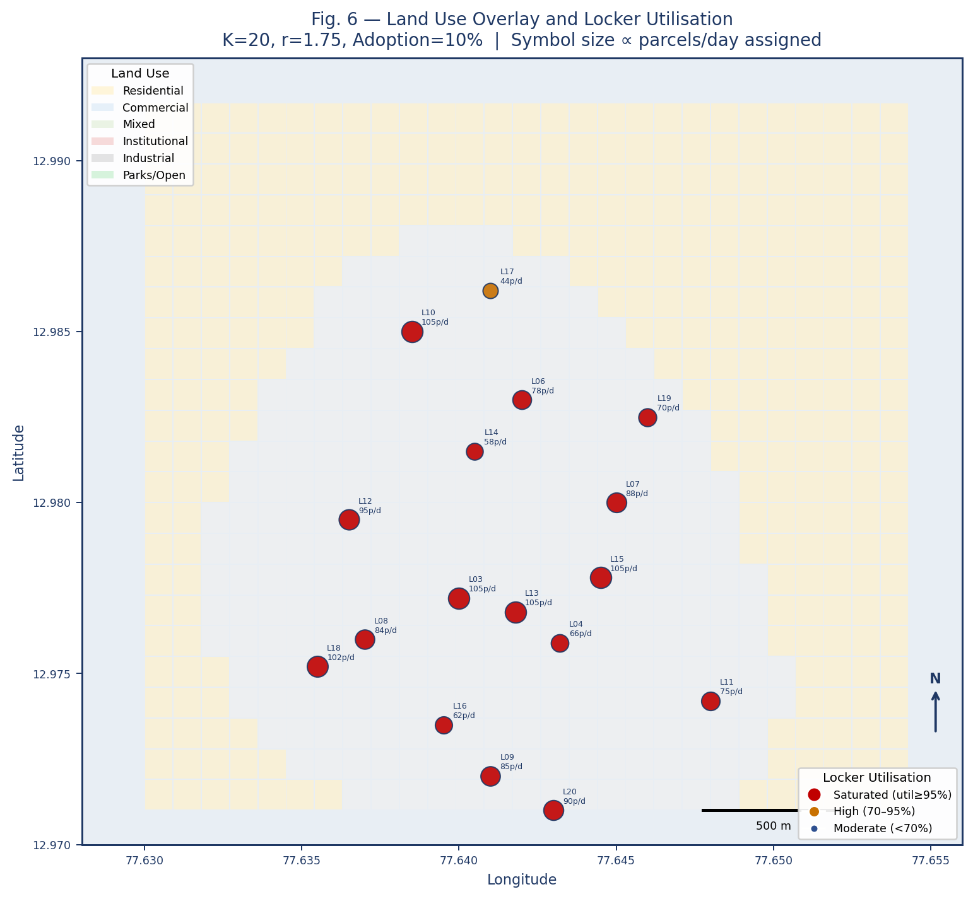
Results Obtained: Locker Utilization Across Urban Land Use Zones
Most fully saturated lockers are concentrated in commercial and mixed-use zones.
Residential-area lockers show comparatively moderate utilization levels.
Commercial corridors generate the highest parcel demand density in the network.
L01, L03, and L13 emerge as priority sites for future capacity upgrades.
Institutional-area lockers show moderate usage compared to metro-adjacent lockers.

Slide 15
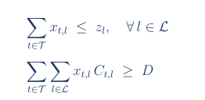
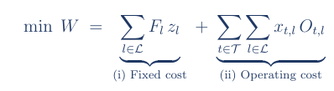

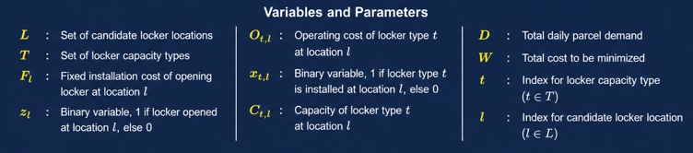
Methodology
Bi-Level Optimization Framework
Subject to:
(Company Decision)
UPPER LEVEL
(1) A locker type can only be selected if the locker site is opened.
(2) Total installed locker capacity must satisfy total parcel demand.
(3) Binary variable for locker opening decision.
(4) Binary variable for locker type selection.

Slide 16
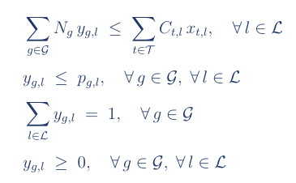

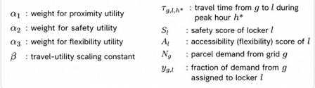
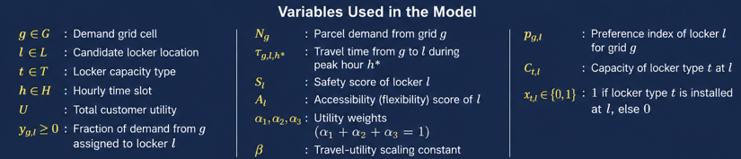
Methodology
Bi-Level Optimization Framework
Subject to:
LOWER LEVEL
(Customer Response)

Slide 17

Methodology (Corradini, et al., (2025))
Bipartite Network Analysis
Dual Centrality (DC)
How many grids have particular locker as their only option
The K=15 MILP solution tells us where to place lockers under normal conditions but not what happens when one fails. So we modelled the network as a weighted bipartite graph: 325 demand grids on one side, 20 locker sites on the other, edges connecting pairs within the 500 m walk limit
Lockers were then removed one by one in worst-case order (highest CC first), re-solving demand allocation after each removal to track exactly when coverage drops below 90% and 80%
Coverage Centrality(CC)
How much demand is lost if the particular locker goes down
G_{reach} (325 demand grids)
L (20 locker sites)
F is the set of feasible edges (pairs (g, l) with d_{g,l} ≤ 500 m)
edge weight is: w_{g,l} =N_{g} . U_{g,l}

Slide 18


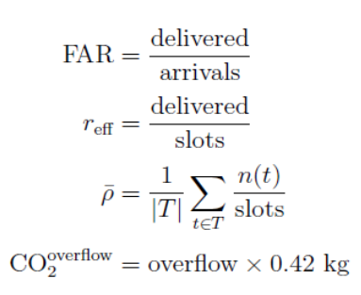
Methodology (Sawik, et al., (2022))
Discrete event simulation
Dual Centrality
Arrival Process:
Pickup Process:
Output Metrics and Validation :
Validate the slot turnover assumption r = 3 and measure first-attempt delivery success rates.
Simulation models 17 open lockers
K=15 MILP solution
16-hour operational day (06:00–22:00, 960 minutes) with 50 independent replications.
Three concurrent SimPy processes
A delivery process (Arrivals as a non-homogeneous Poisson process)
A pickup process(rate proportional to current occupancy with a 3× evening peak multiplier from 18:00–21:00)
Monitor process (occupancy snapshots every 15 minutes)

Slide 19
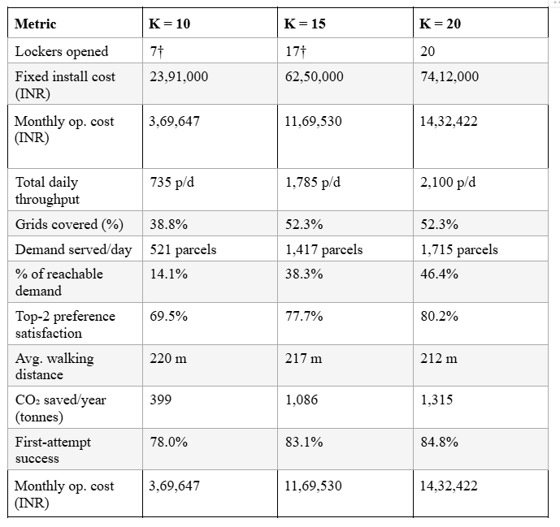
K-Sensitivity Analysis (Phase 1, r = 3)
Coverage ceiling is 52.3% regardless of K- 296 grids have no candidate site within 500 m, so adding more lockers from the same set changes nothing.
K = 15 is the cost-efficiency elbow - marginal cost per parcel rises from ₹39.6 to ₹40.1 beyond K = 15, making K = 20 a case of diminishing returns.
Solver chose Large-type lockers exclusively across all three scenarios best cost-per-slot ratio wins every time.

Slide 20
Bipartite Network Analysis
Dual Centrality
Coverage Centrality
L11 (Binnamangala) is the most structurally irreplaceable 24 peripheral grids have it as their only locker within 500 m, closure creates an immediate service void
L12, L10, and L18 are doubly critical high DC and high CC simultaneously, making them priority-maintenance sites that should never close without mobile backup
30.2% of reachable grids have only one locker option nearly a third of the covered area is one failure away from losing service entirely
L03, L10, L13, and L15 each carry 7.4% of baseline demand removing any one of them causes immediate overflow as every neighbouring locker is already at full capacity
DC and CC reveal two different types of criticality peripheral lockers fail by structure (no alternatives nearby), central lockers fail by capacity (alternatives exist but are saturated)
Network can absorb only 1 simultaneous failure before dropping below 90% coverage removing just L03 drops it from 100% to 92.6%

Slide 21
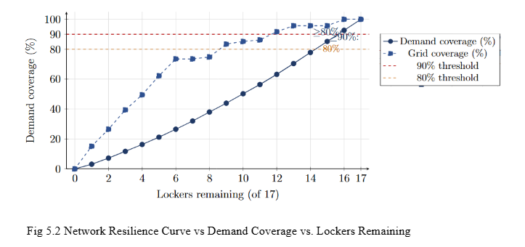
Disruption Curve Visualisation
The network tolerates only 1 simultaneous failure removing the single highest-impact locker (L03) immediately drops demand coverage from 100% to 92.6%
Coverage loss is predictable until it isn't steady 7% drop per locker from 17 down to 9, then collapses sharply as peripheral sites get overwhelmed by rerouted demand
Grid coverage is more resilient than demand coverage at 10 lockers remaining, 85% of grids still have access but demand served has already fallen sharply, because peripheral grids are low-volume but structurally isolated
Minimum safe threshold is 16 of 17 lockers below this the network breaches 90% demand coverage, and below 15 it breaches 80%

Slide 22
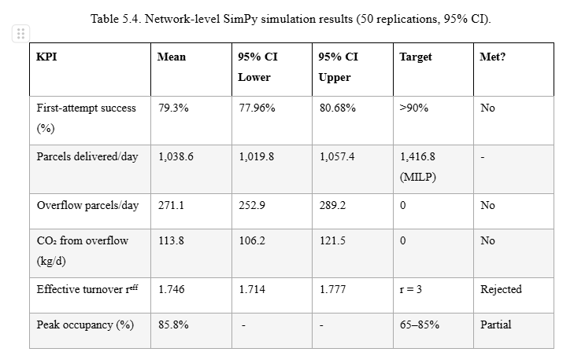
The assumed turnover of r = 3 was wrong by 72%, simulation found reff = 1.746, lockers simply don't free up slots fast enough to reuse them 3 times a day
Evening demand is the culprit, 36.7% of parcels arrive in just a 2-hour window, slots fill faster than customers collect, and 12 of 17 lockers hit near-full by 19:00
First-attempt success of 79.3% misses the 90% target, 271 parcels overflow daily with nowhere to go, adding 113.8 kg of unnecessary CO₂ from re-deliveries
Mornings are wasted, evenings are overwhelmed, occupancy stays below 35% before 15:00 then breaches the safe upper limit by 19:00, a demand timing problem, not a capacity problem

Slide 23
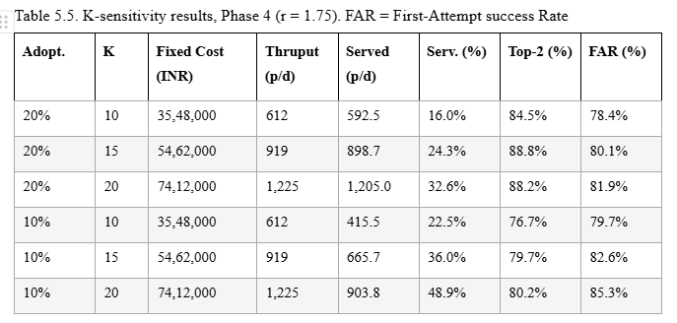
K-Sensitivity Analysis (Phase 4, r = 1.75)
20% adoption is infeasible at current scale even with all 20 lockers open, maximum throughput is only 1,225 parcels/day, covering just 32.6% of reachable demand at 20% adoption
Recommended configuration: K = 20, all Large type, at 10% adoption delivers 48.9% demand coverage, 85.3% FAR (closest achievable to the 90% target), and 80.2% top-2 preference satisfaction at a fixed cost of ₹74.1L
Large type wins at every site best cost-per-slot ratio at ₹5,700–6,200 versus ₹7,125 for Small and Medium, so the solver picks Large exclusively across all scenarios
7 of 20 lockers are already fully saturated at just 10% adoption all in commercial zones along 100 Feet Road and CMH Road, confirming that capacity expansion in the central corridor is the most urgent operational priority

Slide 24
Conclusion
Corrected model recommends all 20 lockers, Large type, at 10% adoption delivers 48.9% coverage, 85.3% FAR, and an estimated 825 tonnes CO₂ saved per year
The network is fragile at the periphery one failure drops coverage below 90%. L10, L12, and L18 are doubly critical (high DC + high CC) and must be priority-maintenance sites.
The assumed turnover of r = 3 was wrong by 72% simulation found reff = 1.746. Evening demand concentration, overnight carryover, and peak saturation are the culprits. First-attempt success at 79.3% misses the 90% target.
Demand is corridor-driven 100 Feet Road–CMH Road is the spine. 7 of 20 lockers saturate at 10% adoption, all in commercial zones. Two new sites near Ulsoor would close the northern coverage gap.

Slide 25
Future expansions planned:
Modular locker architecture - replace fixed S/M/L types with demand-adaptive units where compartment count scales dynamically; study InPost's APM design for integration into the current MILP framework.
Real data pipeline - partner with an operator (Delhivery, Bluedart, or Amazon India) to replace synthetic demand with GPS-traced delivery data, directly improving the demand surface, preference index, and turnover calibration.
Pricing and incentive modelling - extend the lower-level model with a price-sensitivity term so locker adoption becomes an endogenous output rather than a fixed input, making the Stackelberg game behaviourally realistic and publishable.

Slide 26
References:
Dayal, E., Unnikrishnan, A., Pani, A., Lakshay, 2025. Optimal location and capacity planning for parcel lockers: A bi-level optimization model considering planners’ and customers’ perspectives. Transp. Res. Rec. 2679 (5), 968–980.
Corradini, R., Castellini, D., Perego, G., 2025. Bipartite network analysis for supply chain resilience in last-mile logistics. Transp. Res. E Logist. Transp. Rev. 193, p. 103852.
Sawik, B., Hernandez, A., Muro, A., Faulin, J., 2022. Multi-Criteria Simulation-Optimization Analysis of Usage of Automated Parcel Lockers: A Practical Approach. Math. 10(23).
Hovi, I. B., & Bø, E. (2024). Unlocking the Potential: How Can Parcel Lockers Drive Efficiency and Environmental Friendliness? Sustainable Futures, 7, 100189.

Slide 27
References:
Hagberg, A., Swart, P., & Chult, D. (2008). Exploring Network Structure, Dynamics, and Function using NetworkX. Proc. SciPy 2008, 11–15.
Vakulenko, Y., Hellström, D., Hjort, K., 2018. What’s in the parcel locker? Exploring customer value in e-commerce last mile delivery. J. Bus. Res. 88, 421–427.
Moslem, S., Pilla, F., 2023. A hybrid decision making support method for parcel lockers location selection. Res. Transp. Econ. 100, 101320.
Campisi, T., Di Ruocco, I., 2025. Accessibility and spatial location of parcel lockers in last-mile delivery: A literature review. Open Transp. J. 19, e26671212391037.

Slide 28
References:
Lachapelle, U., Burke, M., Brotherton, A., Leung, A., 2018. Parcel locker systems in a car dominant city: Location, characterisation and potential impacts on city planning and consumer travel access. J. Transp. Geogr. 71, 1–14.
Zhang, Q., Demir, E., 2025. Parcel locker solutions for last mile delivery: A systematic literature review and future research directions. Front. Future Transp. 6, 165462.

Slide 29
Thank You

